Slide 1
Final Project ------ ResNet
Group 3
Team Members: Albert, Jack, Tiger

Slide 2
Index
Introduction
Problems in deep neuron network
ResNet solves problems
How ResNet works
Methodology
Dataset and Code
Results
ResNet VS PlainNet
Identity Shortcut VS Projection Shortcut
Improvement of ResNet101
Conclusions
What we learned
Possible improvements

Slide 3
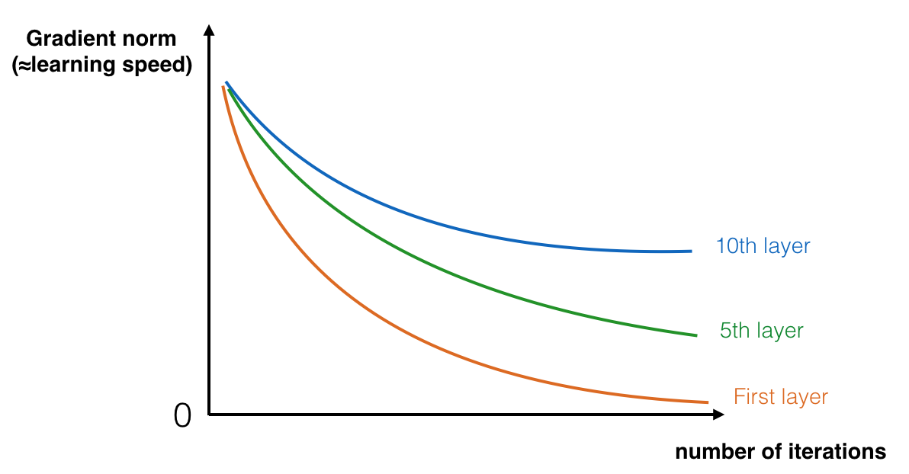
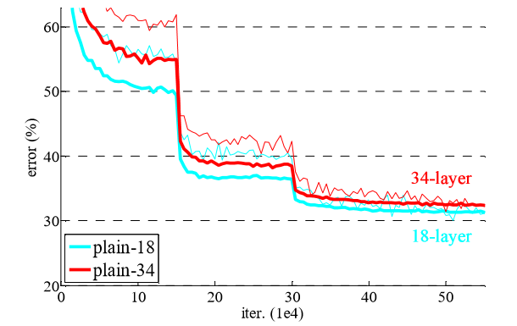
Introduction - Problems in deep neuron network
Vanishing gradient
Degradation problems
[1]
[2]
[1] Priya, Dwivedi. (January 4). Understanding and Coding a ResNet in Keras. Retrieved from https://towardsdatascience.com/understanding-and-coding-a-resnet-in-keras-446d7ff84d33
[2] Kaiming He, Xiangyu Zhang, Shaoqing Ren, & Jian Sun. (2016). Deep Residual Learning for Image Recognition. 2016 IEEE Conference on Computer Vision and Pattern Recognition (CVPR). IEEE Computer Society.

Slide 4
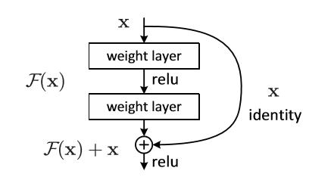
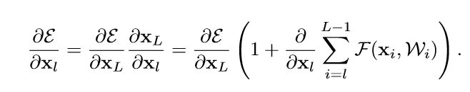

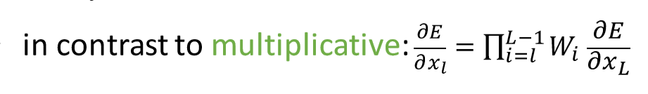
Introduction - ResNet solves problems
ResNet solves vanishing gradient and degradation problems
[4]
[3]
[5]
[3, 4, 5] He, K., Zhang, X., Ren, S., & Sun, J. (2016, October). Identity mappings in deep residual networks. In European conference on computer vision (pp. 630-645). Springer, Cham.

Slide 5
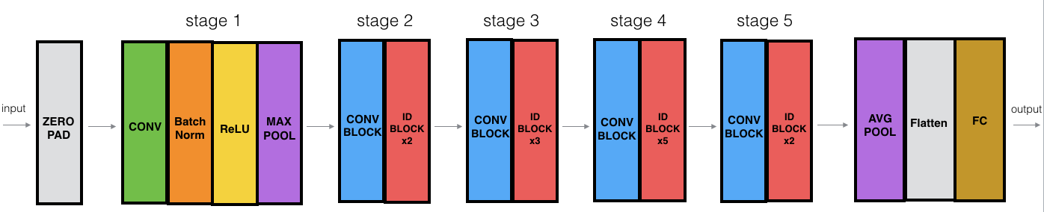

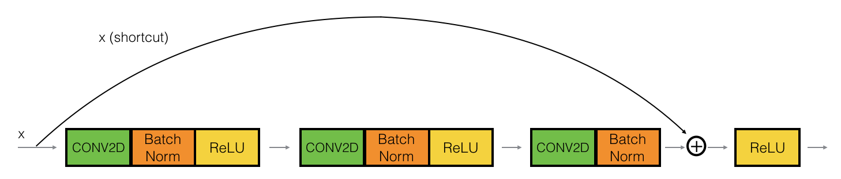
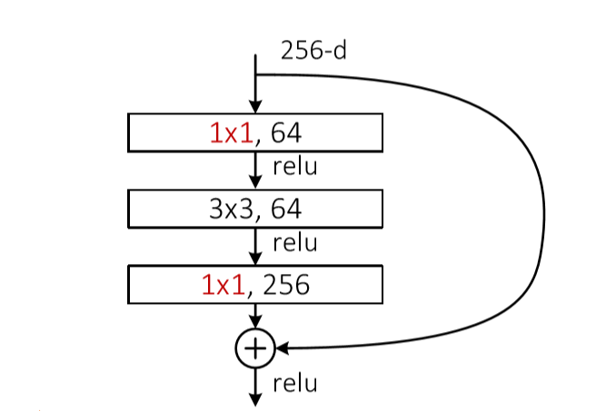
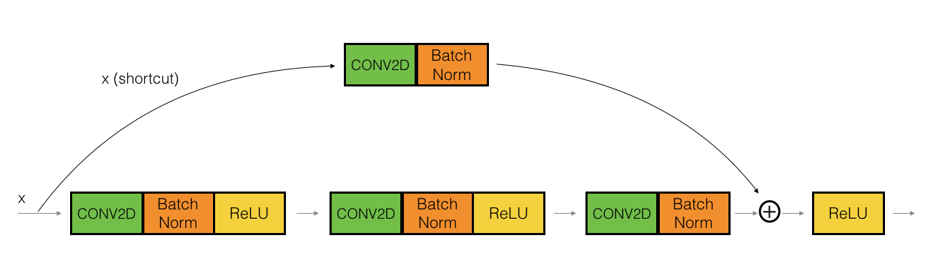
Introduction - How ResNet works
ResNet50
Skip Connection
[6]
[8]
Less parameters Save time!
[7]
[6, 7, 8] Priya, Dwivedi. (January 4). Understanding and Coding a ResNet in Keras. Retrieved from https://towardsdatascience.com/understanding-and-coding-a-resnet-in-keras-446d7ff84d33

Slide 6
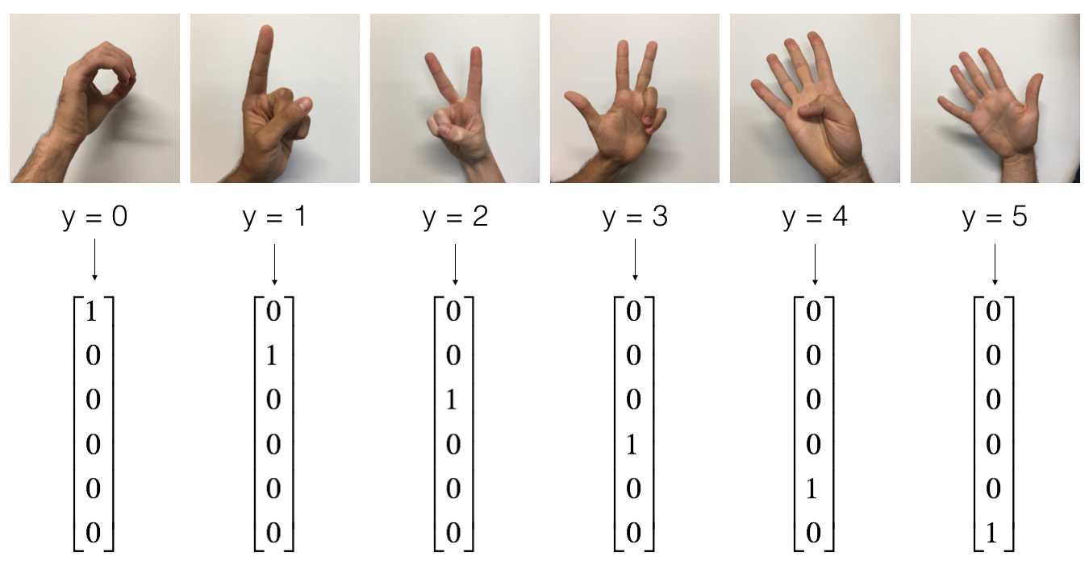
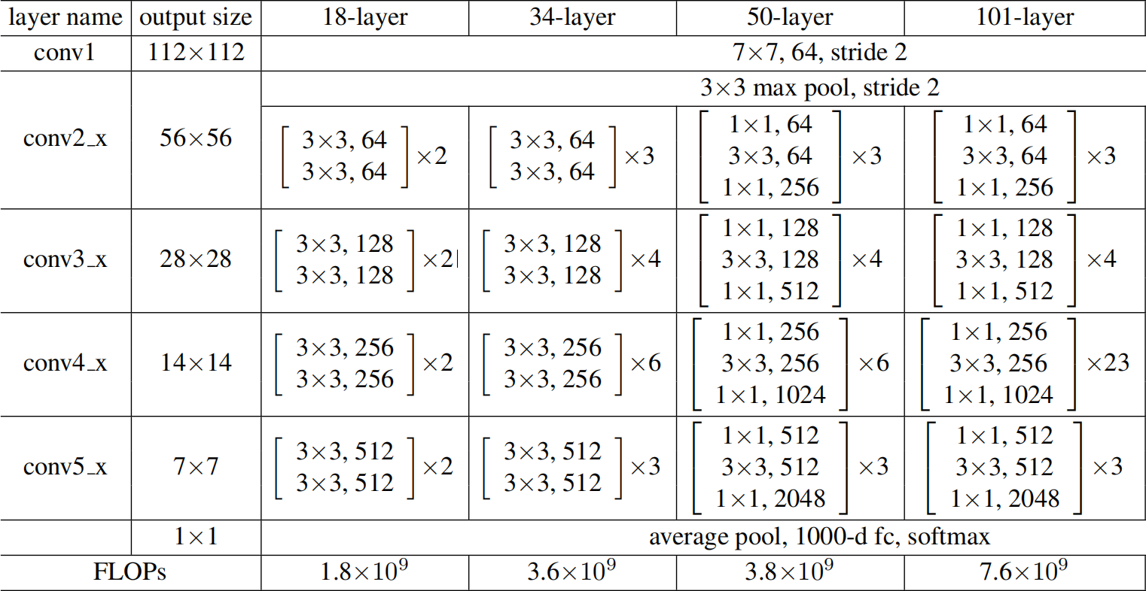
Methodology - Dataset and Code
Dataset
Name | Hand Images
Train images | 1080
Test images | 120
Classes | 6
Models
Details
Validation images | 162
Epochs | 100
Batch size | 32
Learning rate | 0.001
Optimizer | Adam
Loss function | Cross Entropy
Activation | Relu
Strategies | Normalization, Checkpoint
[9]
[9] Kaiming He, Xiangyu Zhang, Shaoqing Ren, & Jian Sun. (2016). Deep Residual Learning for Image Recognition. 2016 IEEE Conference on Computer Vision and Pattern Recognition (CVPR). IEEE Computer Society.

Slide 7
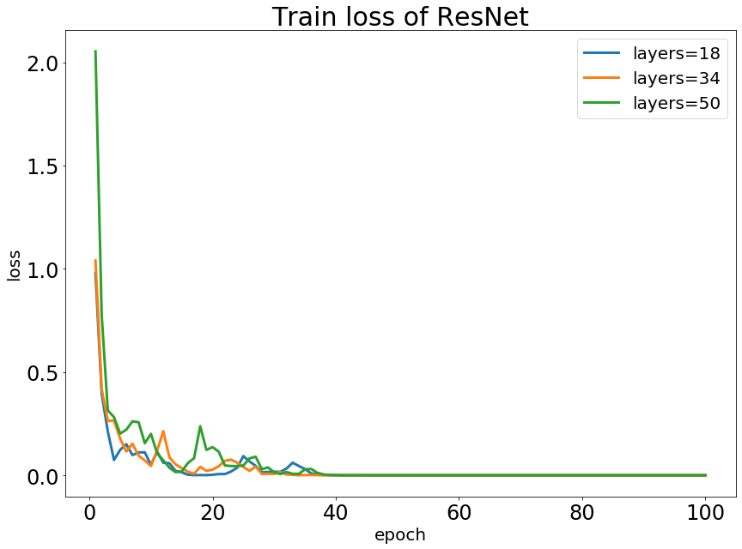
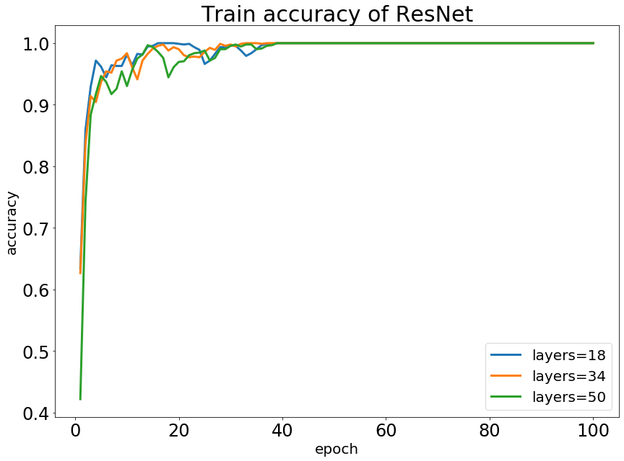
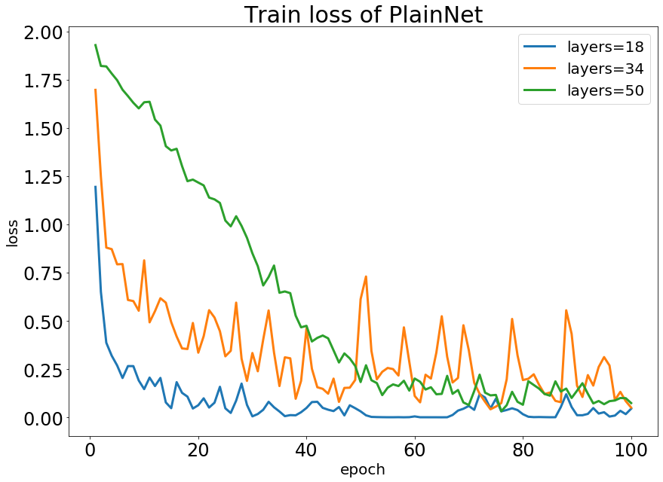
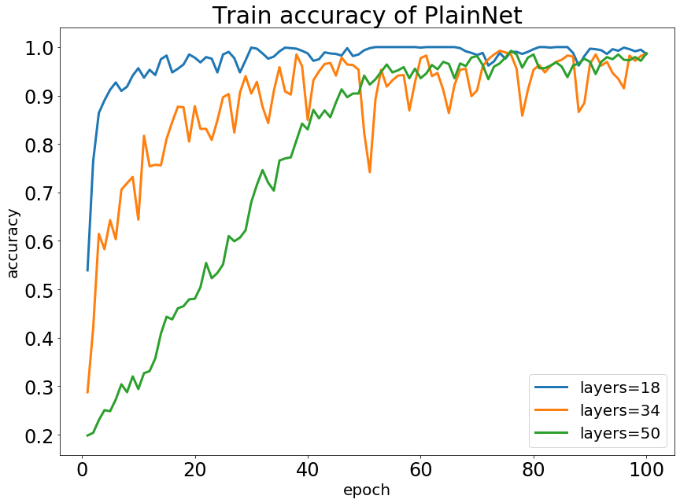
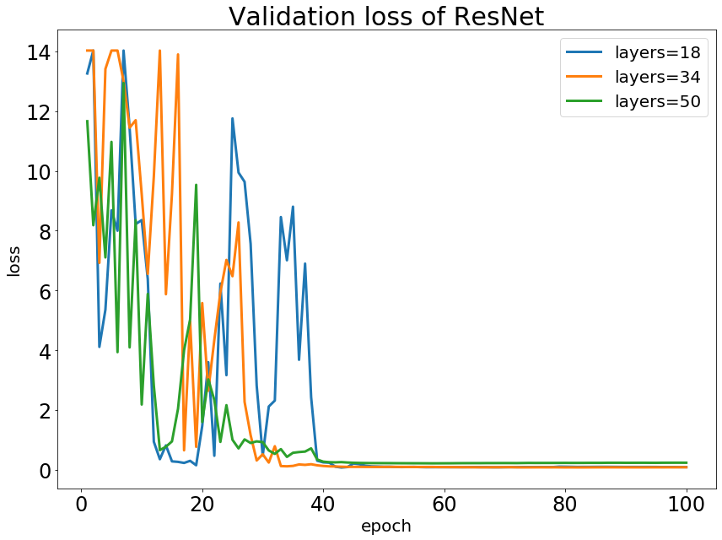
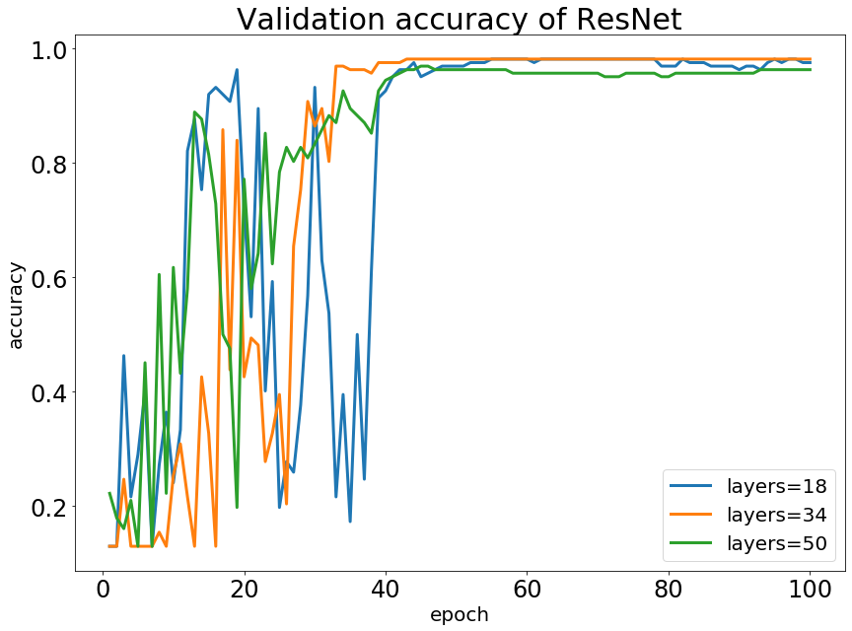
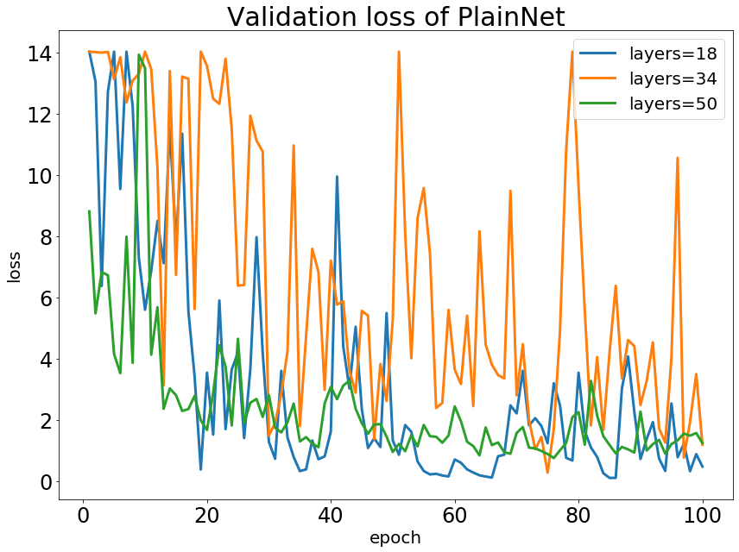
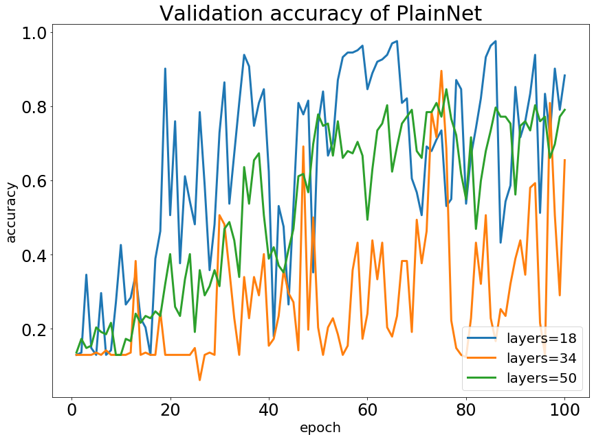
Results - ResNet VS PlainNet
ResNet | Test Accuracy/%
18 layers | 97.50
34 layers | 98.33
50 layers | 97.50
PlainNet | Test Accuracy/%
18 layers | 100.00
34 layers | 92.50
50 layers | 80.00
PlainNet | Test Accuracy/%
18 layers | 100.00
34 layers | 92.50
50 layers | 80.00

Slide 8
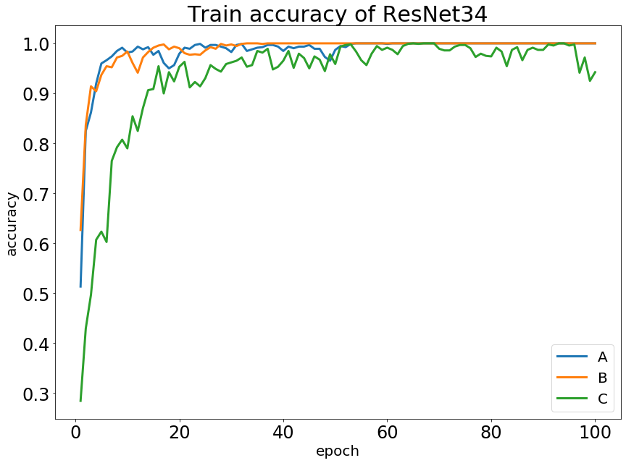
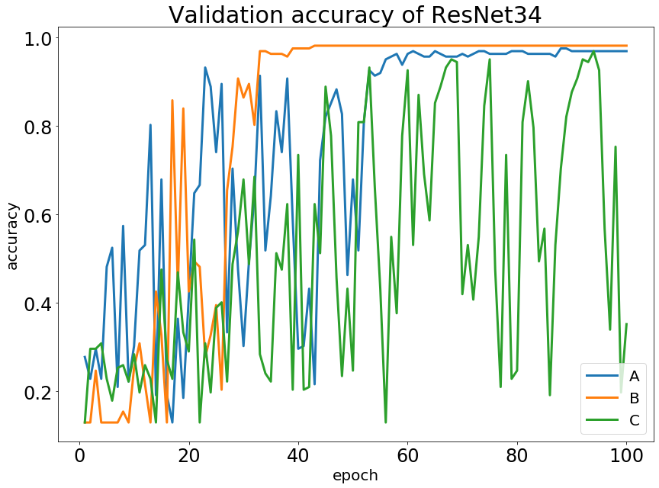
Results - Identity Shortcut VS Projection Shortcut
Models
Results
Model | Number of Params | Train time/s | Test Acc/%
A | 21121542 | 1908 | 99.17
B | 22672518 | 1976 | 98.33
C | 30901830 | 2668 | 99.17
A. Identity for all
B. Both
C. Projection for all

Slide 9
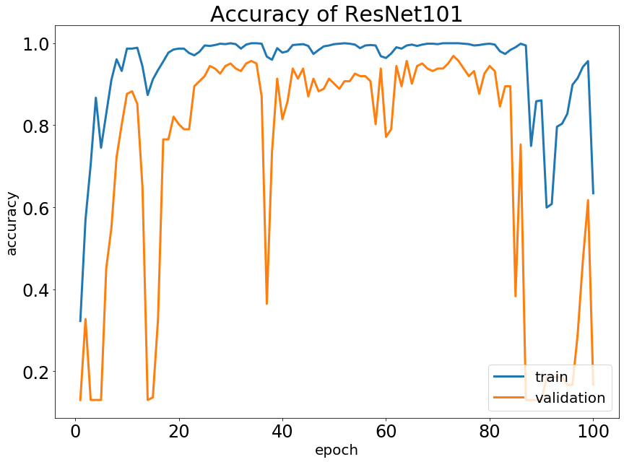
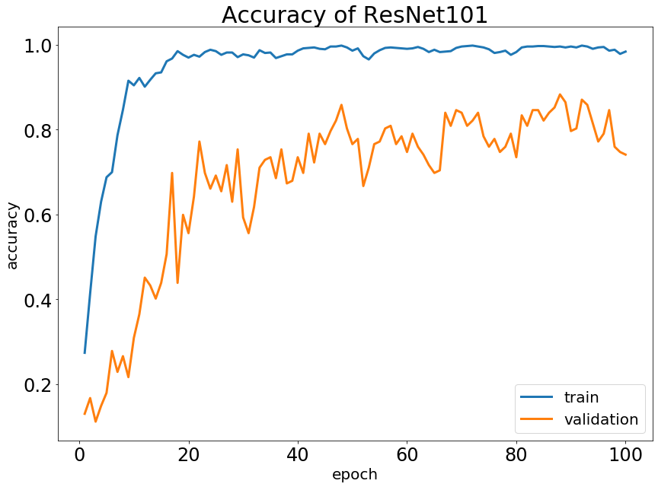
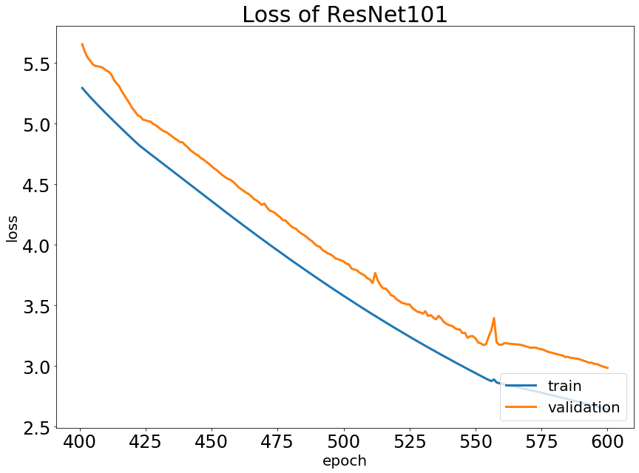
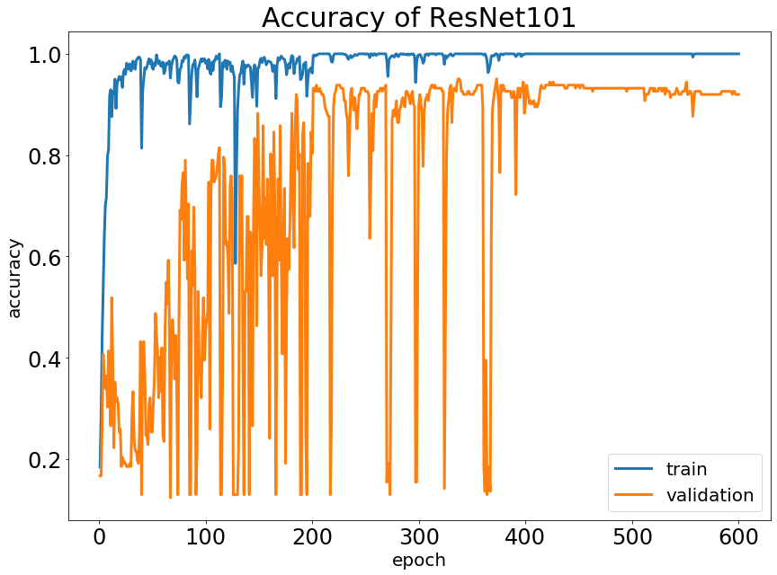
Results - Improvement of ResNet101
Dropout
L2 Regularization
Epoch 100-->600
Learning Rate
0.001-->0.0002
Oringinal
Interim
Final
Learning Rate divided by 10 per 200 epochs

Slide 10
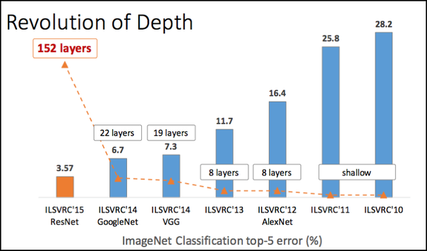

Conclusions - What we learned
ResNet makes deeper neuron network possible!
ResNet helps solve two main problems.
1. Vanishing gradient
allow gradient to flow through alternative shortcut path
2. Degradation problems
make it easier to learn an identity function
(Complete explanations are shown in a paper, Identity Mappings in Deep Residual Networks)
Further understandings of ResNet
1. Make the structure more flexible
2. Combine features of shallow layers and deeper layers
[11]
[10]
[10] Priya, Dwivedi. (January 4). Understanding and Coding a ResNet in Keras. Retrieved from https://towardsdatascience.com/understanding-and-coding-a-resnet-in-keras-446d7ff84d33
[11] Kaiming He, Xiangyu Zhang, Shaoqing Ren, & Jian Sun. (2016). Deep Residual Learning for Image Recognition. 2016 IEEE Conference on Computer Vision and Pattern Recognition (CVPR). IEEE Computer Society.

Slide 11
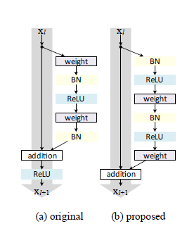
Conclusions - Possible improvements
Add some regularizations (For example, L2) to a really deep ResNet
Change the structure in the block
Add some other paths in the block or between blocks
[12]
Block 1
In the block
Between blocks
Conv layers
identity
Conv
identity
Conv
identity
Block 2
Conv
Conv layers
identity
[12] He, K., Zhang, X., Ren, S., & Sun, J. (2016, October). Identity mappings in deep residual networks. In European conference on computer vision (pp. 630-645). Springer, Cham.

